Slide 1




When you got up this morning, I observed you, and I hoped you would talk to me,
No matter if they were only few words, asking my opinion or just giving thanks for something that happened to you yesterday.
But I noticed that you were very busy looking for the appropriate clothes to wear and to go to work.

Slide 2


I continued hoping,
While you were doing things in a hurry,
I knew that there were still some minutes for you to stop for a moment and tell me “Hello!”,
But you were too much busy.
This is why I lighted the sky for you,
I filled it with colors and beautiful songs of birds
To see if you would hear me.
But you did not notice this.

Slide 3

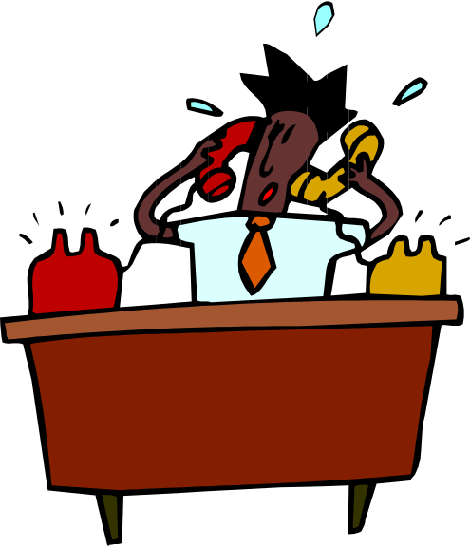

I observed you while going to work
And I waited patiently the whole day.
With all your activities I suppose you were too much busy to tell me something.
While you were coming back I noticed your tiredness and I wanted to shower upon you some water to take away your stress,
I wanted to make you a favor so that you would think of me,
But you got angry and offended my name.
I really wished you would talk to me… there was still enough time.

Slide 4
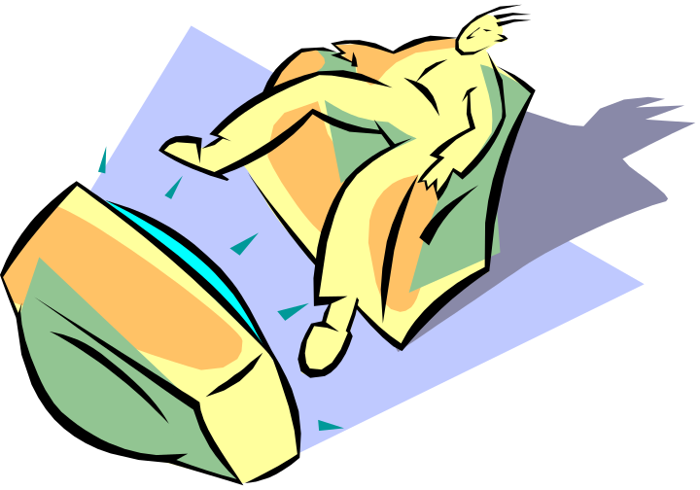



Later on you turned on the television,
I waited patiently while you were watching it and having your supper,
But you forgot again to talk to me…
I noticed that you were tired and I understood your silence, so I darkened the clarity of the sky,
But I did not leave you in darkness, I just changed it with a small light,
it was really beautiful, but you were not interested in seeing it.

Slide 5

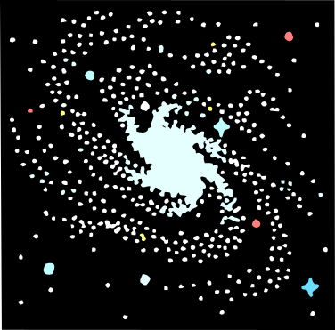



At the time of sleeping, I think you were already exhausted.
After saying good night to your family,
You lay on your bed and fell asleep almost instantly,
I accompanied your sleep with music, my night animals did very well,
No problem, because you might not realize that I am always there for you.

Slide 6

I have more patience than what you can imagine.
I would like to teach you also how to be patient with others.
I LOVE YOU so much that I wait every day for a prayer.
The landscape that I make is only for you …
Well, you are getting up again
And I hope again, just out of my love for you
May you have a nice day !!!!
Your friend God

